Slide 1


Module 12 – Pricing and Licensing

Slide 2
Understanding Operational Costs
Principles of Purview Pricing
Pricing In Practice
Fair Market Value
Consumption-Based
Customer in Control
Transparent & Explainable
Unified Catalog: A $0.0165 per asset per day or approximately $0.50 per unique Governed Asset per month cost. This covers Data Curation, Discovery, and Governed Access Polices.
Data Management: A $15 (basic) / $60 (standard) / $240 (advanced) cost per Data Governance Processing Unit (DGPU). This covers Data Quality scanning and Health Controls - calculated on 60-minutes of processing time.
Notes:
🫂 Team Activity: [15 minutes] Spend a few minutes reading through the context and pricing information below and have a conversation about it.
Do you understand the definition of a Governed Asset?
Can you estimate the average number of assets linked to a data product.
Principles of Purview Pricing
Fair Market Value - Microsoft Purview is priced to reflect the value it provides to customers. The pricing is based on the features and capabilities that are included in the service.
Consumption-Based - Microsoft Purview is a consumption-based service. You only pay for what you use.
Customer in Control - Microsoft Purview is designed to give customers control over their costs. You can predict, monitor, and manage your governance costs.
Transparent & Explainable - Going forward, Microsoft Purview pricing is transparent and easy to understand.
Pricing In Practice
There are two predictable billing meters that factor into the cost of operating Microsoft Purview. All prices are in US Dollars (USD).
Unified Catalog: A $0.0165 per asset per day or approximately $0.50 per unique Governed Asset per month cost. This covers Data Curation, Discovery, and Governed Access Polices.
Data Management: A $15 (basic) / $60 (standard) / $240 (advanced) cost per Data Governance Processing Unit (DGPU). This covers Data Quality scanning and Health Controls - calculated on 60-minutes of processing time.
If you previously operated Azure Purview (classic), note the always-on Data Map / Scanning / API costs have been subsumed and no longer apply in Microsoft Purview Data Governance.
Security Copilot: Optionally, you may wish to integrate the Security Copilot capabilities into Microsoft Purview. Security Copilot is a separate service that provides advanced security and compliance capabilities for Microsoft Purview and broader Microsoft Security products. It is optional and thus priced separately.

Slide 3
Unified Catalog: What is a Governed Asset?
A Data Asset which is curated for discovery in the Unified Catalog is considered 'governed' when either of these conditions are met (full details):
It is attached to a Data Product or Critical Data Element
It is annotated with a Term (glossary)
Examples in Practice
Example 1: A SQL table is referenced within a data product. The same SQL table is used in five other data products. The SQL table is counted one time only, once a day.
Example 2: I have created 50 governance domains and data products. But haven't attached any tables or files/reports/dashboards. In this case I won't be charged for any governed asset.
Example 3: I accidentally attached a server to the data product. Purview counts just the server as a single asset, not all the children tables within it
Notes:
. Unified Catalog: What is a Governed Asset?
A Data Asset which is curated for discovery in the Unified Catalog is considered 'governed' when either of these conditions are met (full details):
It is attached to a Data Product or Critical Data Element
It is annotated with a Term (glossary), Custom Attribute
In other words, you can scan metadata into Microsoft Purview's Data Map (Multi-cloud Tables, Files, Datasets, Reports, Dashboards, Models etc.) without incurring costs until you decide to govern them. On average, only a minority (15-25%) of all assets are governed (in a large organization).
FeatureSKUPay-As-You-Go PriceUnified CatalogStandard$0.0165 per asset per day or ~ $0.50 per monthExamples in Practice
Example 1: A SQL table is referenced within a data product. The same SQL table is used in five other data products. The SQL table is counted one time only, once a day.
Example 2: I have created 50 governance domains and data products. But haven't attached any tables or files/reports/dashboards. In this case I won't be charged for any governed asset.
Example 3: I accidentally attached a server to the data product. Purview counts just the server as a single asset, not all the children tables within it

Slide 4
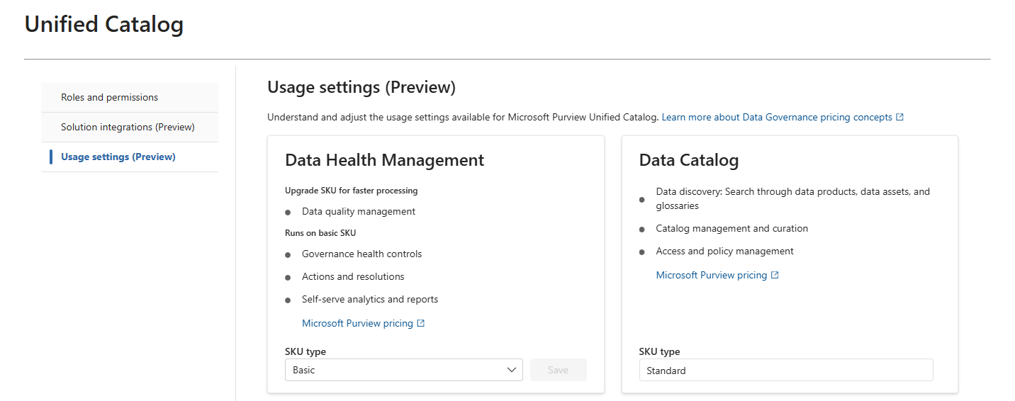
Data Management: How is the SKU Determined?
Feature | SKU | Pay-As-You-Go Price | vCores
Data Health Management | Basic | $15 per Data Governance Processing Unit | Up to 8
Data Health Management | Standard | $60 per Data Governance Processing Unit | Up to 16
Data Health Management | Advanced | $240 per Data Governance Processing Unit | Up to 32
A Data Governance Processing Unit (DGPU) equates to 60 minutes of data management compute
It is consumed by data quality, health controls and future data management capabilities.
All deployments of Microsoft Purview default to the Basic tier
Switching Between SKUs/Tiers
Notes:
Data Management: How is the SKU Determined?
Data management processing is high-value compute for data management workloads in most organizations. It is consumed by data quality, health controls and future data management capabilities. Data management compute utilization varies but factors that influence the cost of data management processing can include:
Data volumes
Complexity of data management rules and policies
Physical topology of the data estate (cloud-based sources, on-premises infrastructure, networking, geo locations and residency requirements)
A Data Governance Processing Unit (DGPU) equates to 60 minutes of data management compute run across varying sets of nodes based on the workload need. The three options provide increasing speed and parallelism for choice and control (prices in USD):
FeatureSKUPay-As-You-Go PricevCoresData Health ManagementBasic$15 per Data Governance Processing UnitUp to 8Data Health ManagementStandard$60 per Data Governance Processing UnitUp to 16Data Health ManagementAdvanced$240 per Data Governance Processing UnitUp to 32Some activities such as Purview introspecting its own metadata store to evaluate health controls, publish metrics into an externally connected Azure Data Lake Gen2 (or Microsoft Fabric OneLake), or assigning health actions do not require higher levels of compute to execute. These activities will always run in the Basic SKU.
Other activities such as executing data quality rules and profiling data, will benefit from a higher SKU to run faster and in parallel. The Standard SKU is recommended for most organizations. This information is also conveyed in Purview's Unified Catalog Settings (see screenshot below).
Switching Between SKUs/Tiers
All deployments of Microsoft Purview default to the Basic tier. Your Data Governance Administrator (role) will be able to change this tier at any time via the Purview Settings page. All data management rules for Data Quality and Data Estate Health will run on a single SKU as a pool of compute.
Examples in Practice
Example: I run 100 Data Management rules and controls in a single day, and each run produces 0.02 DGPU with the Basic SKU, then the total DGPU for that day would equal two (0.02 * 100) DGPU, costing me $30.

